Slide 1



BD_Conflict_Viz
View in Power BI
Last data refresh:
12/22/2021 6:35:24 AM UTC
Downloaded at:
12/22/2021 10:59:24 AM UTC

Slide 2
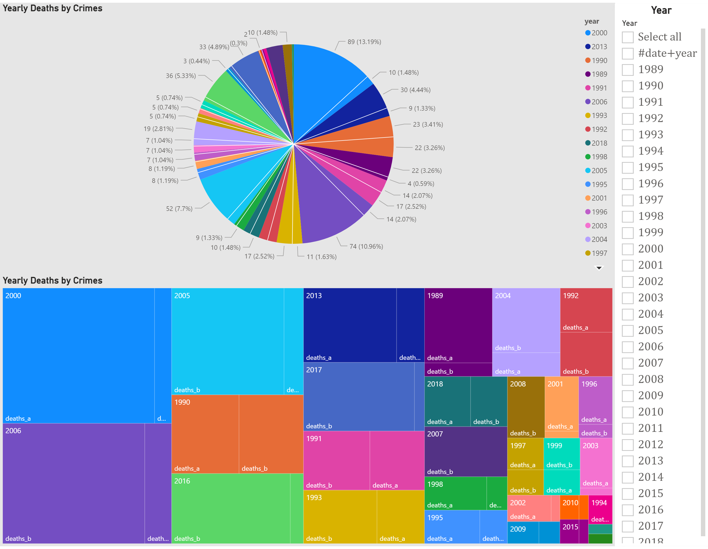
Page 1
Notes:
Yearly Deaths by Crimes
No alt text provided
Yearly Deaths by Crimes
No alt text provided
Year
No alt text provided

